Slide 1
TRANSFORMATION OF FUNCTION OF A RANDOM VARIABLE
UNIVARIATE TRANSFORMATIONS

Slide 2
TRANSFORMATION OF RANDOM VARIABLES
If X is an rv with cdf F(x), then Y=g(X) is also an rv.
If we write y=g(x), the function g(x) defines a mapping from the original sample space of X, S, to a new sample space, , the sample space of the rv Y.
g(x): S→ 

Slide 3
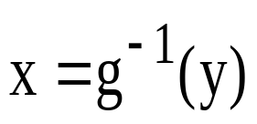
TRANSFORMATION OF RANDOM VARIABLES
Let y=g(x) define a 1-to-1 transformation. That is, the equation y=g(x) can be solved uniquely:
Ex: Y=X-1 → X=Y+1 1-to-1
Ex: Y=X² → X=± sqrt(Y) not 1-to-1
When transformation is not 1-to-1, find disjoint partitions of S for which transformation is 1-to-1.

Slide 4
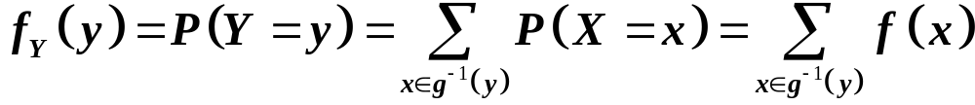
TRANSFORMATION OF RANDOM VARIABLES
If X is a discrete r.v. then S is countable. The sample space for Y=g(X) is ={y:y=g(x),x∈ S}, also countable. The pmf for Y is

Slide 5
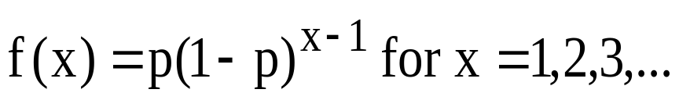
Example
Let X~GEO(p). That is,
Find the p.m.f. of Y=X-1
Solution: X=Y+1
P.m.f. of the number of failures before the first success
Recall: X~GEO(p) is the p.m.f. of number of Bernoulli trials required to get the first success

Slide 6
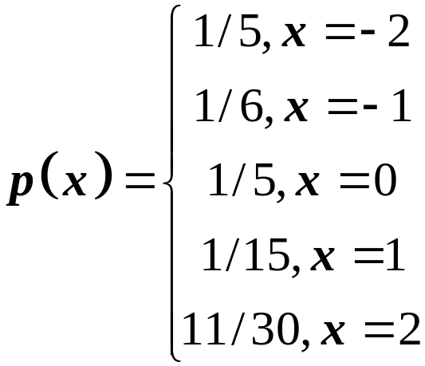
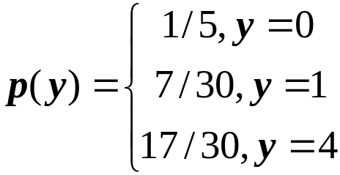
Example
Let X be an rv with pmf
Let Y=X².
S ={−2, − 1,0,1,2}
 ={0,1,4}

Slide 7
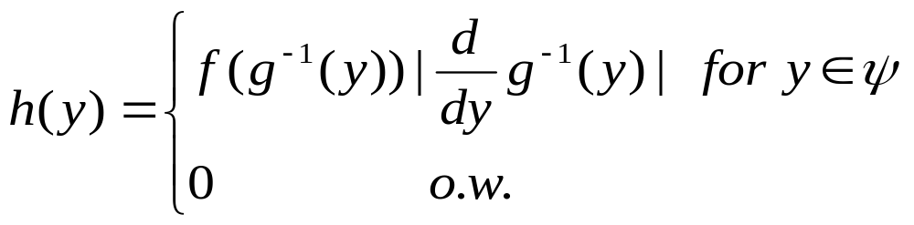
FUNCTIONS OF CONTINUOUS RANDOM VARIABLE
Let X be an rv of the continuous type with pdf f. Let y=g(x) be differentiable for all x and non-zero. Then, Y=g(X) is also an rv of the continuous type with pdf given by

Slide 8
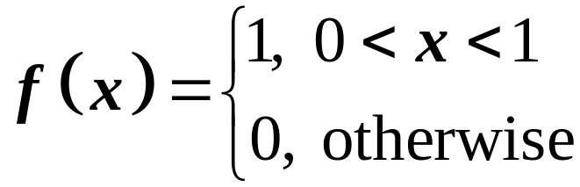
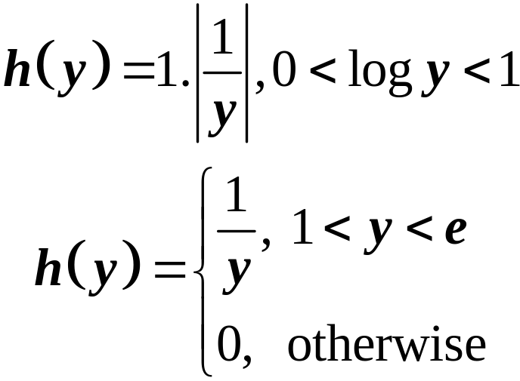
FUNCTIONS OF CONTINUOUS RANDOM VARIABLE
Example: Let X have the density
Let Y=e^{X}.
X=g⁻¹ (y)=log Y→ dx=(1/y)dy.

Slide 9
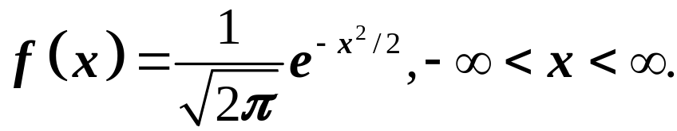
FUNCTIONS OF CONTINUOUS RANDOM VARIABLE
Example: Let X have the density
Let Y=X². Find the pdf of Y.

Slide 10
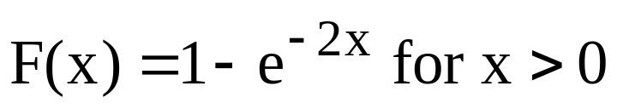
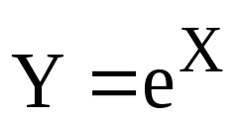
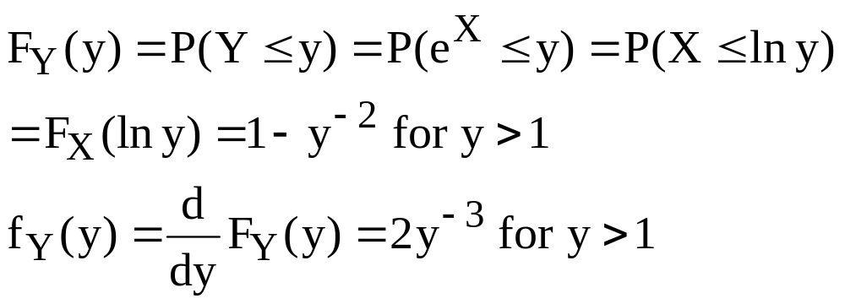
CDF method
Example: Let
Consider . What is the p.d.f. of Y?
Solution:

Slide 11
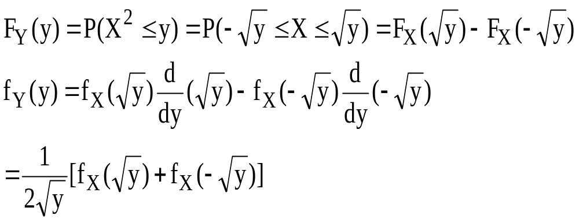
CDF method
Example: Consider a continuous r.v. X, and Y=X². Find p.d.f. of Y.
Solution:

Slide 12
TRANSFORMATION OF FUNCTION OF TWO OR MORE RANDOM VARIABLES
BIVARIATE TRANSFORMATIONS

Slide 13
DISCRETE CASE
Let X₁ and X₂ be a bivariate random vector with a known probability distribution function. Consider a new bivariate random vector (U, V) defined by U=g₁(X₁, X₂) and V=g₂(X₁, X₂) where g₁(X₁, X₂) and g₂(X₁, X₂) are some functions of X₁ and X₂ .

Slide 14
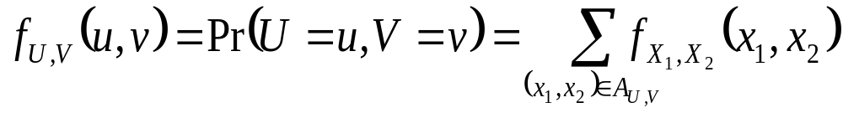
DISCRETE CASE
Then, the joint pmf of (U,V) is

Slide 15
EXAMPLE
Let X₁ and X₂ be independent Poisson distribution random variables with parameters θ₁ and θ₂. Find the distribution of U=X₁+X₂.

Slide 16
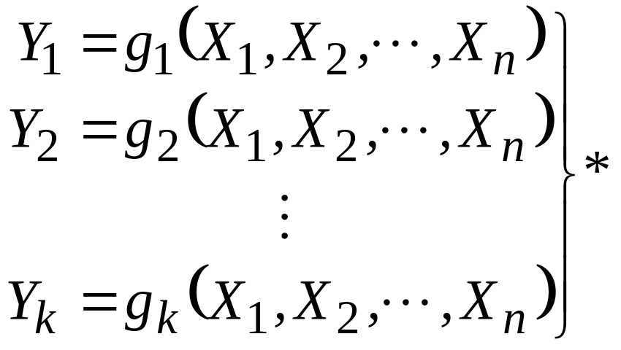
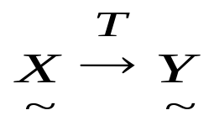
CONTINUOUS CASE
Let X=(X₁, X₂, …, X_{n}) have a continuous joint distribution for which its joint pdf is f, and consider the joint pdf of new random variables Y₁, Y₂,…, Y_{k} defined as

Slide 17
CONTINUOUS CASE
If the transformation T is one-to-one and onto, then there is no problem of determining the inverse transformation, and we can invert the equation in (*) and obtain new equations as follows:

Slide 18
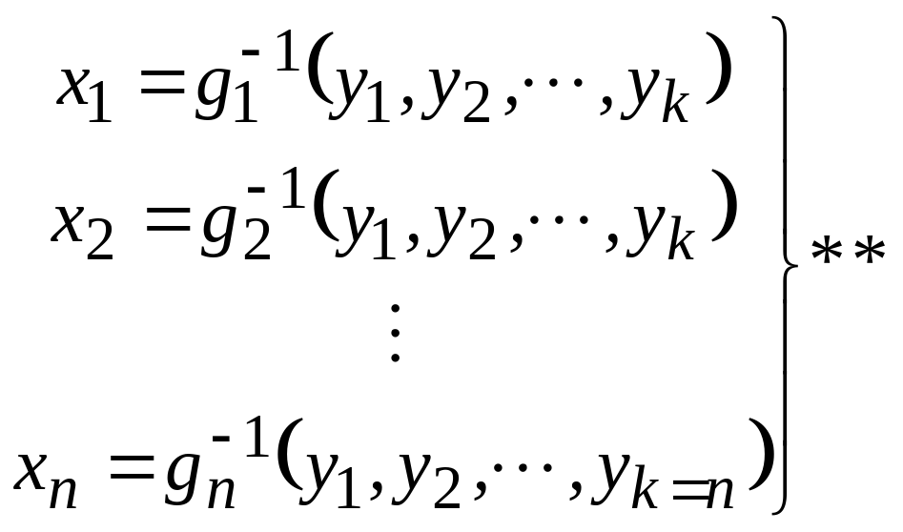
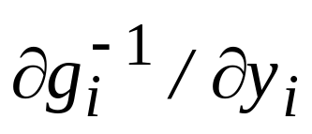
CONTINUOUS CASE
Assuming that the partial derivatives exist at every point (y₁, y₂,…,y_{k=n}). Under these assumptions, we have the following determinant J

Slide 19
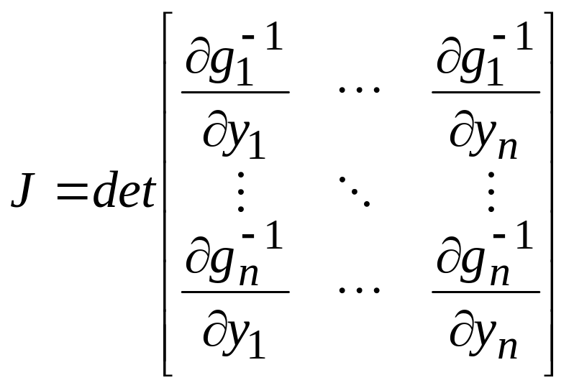
CONTINUOUS CASE
called as the Jacobian of the transformation specified by (**). Then, the joint pdf of Y₁, Y₂,…,Y_{k} can be obtained by using the change of variable technique of multiple variables.

Slide 20
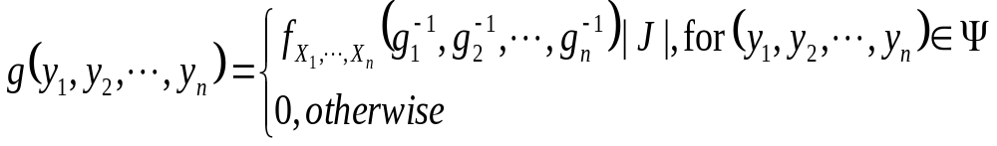
CONTINUOUS CASE
As a result, the new p.d.f. is defined as follows:

Slide 21
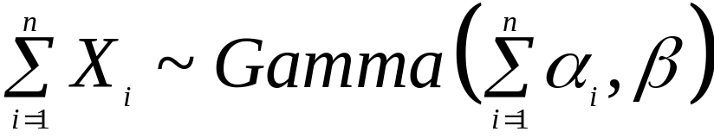
Example
Recall that I claimed: Let X₁,X₂,…,X_{n} be independent rvs with X_{i}~Gamma(α_{i}, β). Then,
Prove this for n=2 (for simplicity).

Slide 22
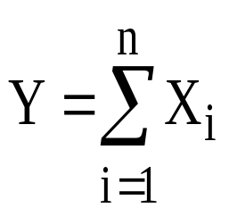
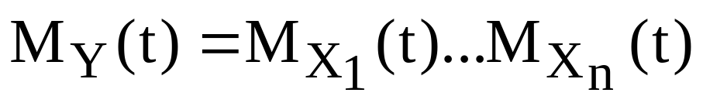
M.G.F. Method
If X₁,X₂,…,X_{n} are independent random variables with MGFs Mxi (t), then the MGF of is

Slide 23
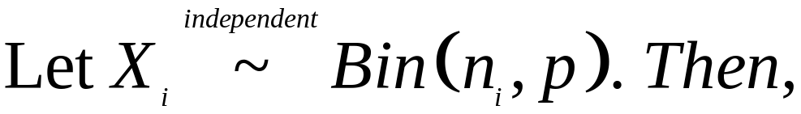
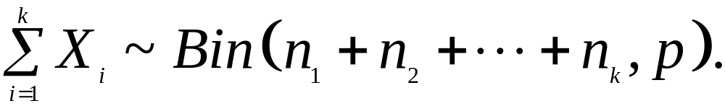
Example
Recall that I claimed:
Let’s prove this.

Slide 24
Example
Recall that I claimed: Let X₁,X₂,…,X_{n} be independent rvs with X_{i}~Gamma(α_{i}, β). Then,
We proved this with transformation technique for n=2.
Now, prove this for general n.

Slide 25
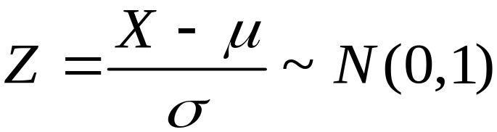
More Examples on Transformations
Example 1:
Recall that I claimed: If X~N(μ , σ²), then
Let’s prove this.

Slide 26
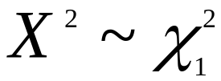
Example 2
Recall that I claimed:
Let X be an rv with X~N(0, 1). Then,
Let’s prove this.

Slide 27
Example 3
Let X~N(μ , σ²) and Y=exp(X). Find the p.d.f. of Y.

Slide 28
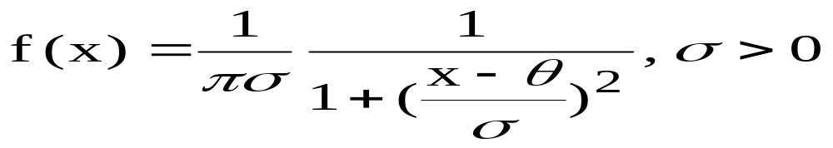
Example 4
Recall that I claimed:
If X and Y have independent N(0,1) distribution, then Z=X/Y has a Cauchy distribution with θ=0 and σ=1.
Recall the p.d.f. of Cauchy distribution:
Let’s prove this claim.

Slide 29
Example 5
See Examples 6.3.12 and 6.3.13 in Bain and Engelhardt (pages 207 & 208 in 2nd edition). This is an example of two different transformations:
In Example 6.3.12: In Example 6.3.13:
X1 & X2 ~ Exp(1)
Y1=X1
Y2=X1+X2
X1 & X2 ~ Exp(1)
Y1=X1-X2
Y2=X1+X2

Slide 30
Example 6
Let X1 and X2 are independent with N(μ1,σ²1) and N(μ2,σ²2), respectively. Find the p.d.f. of Y=X1-X2.

